Slide 1
The Software Potato
TestFlix 2022
Rikard Edgren
rikard.edgren@nordicmedtest.se
Notes:
Hi. I am Rikard, a software tester from Sweden, working with national infrastructure for information communication in health care.
I have been doing testing for 24 years now, and I still love it. I enjoy the combination of understanding the whole picture and digging into details, and also the dynamics between the technical side of computers, and the humanistic side of people creating software for people.
And I know that good testing is needed.
Today I want to share a model I have used for some years, and I hope it can be interesting for you.

Slide 2
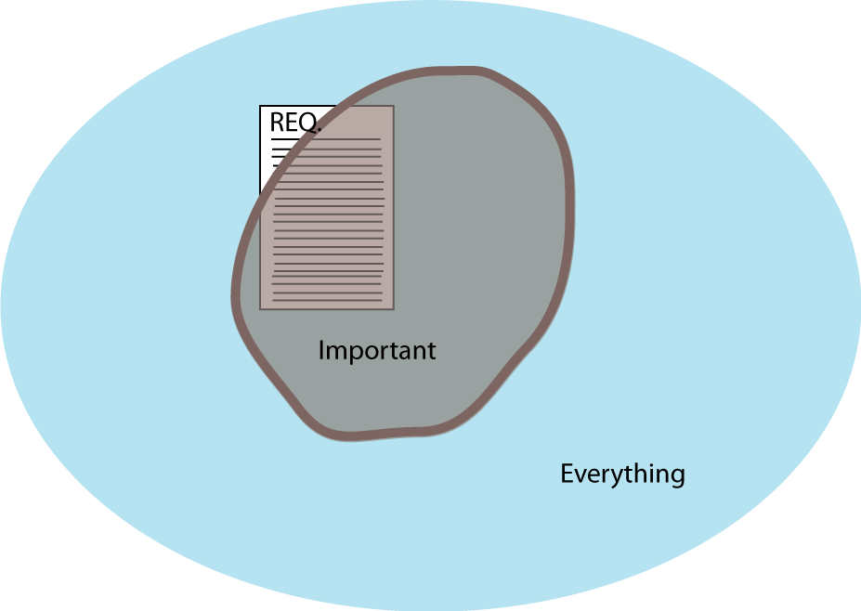
there are always more things that are important, but not everything is important
Notes:
This is my basic model.
The square in the middle symbolizes the features and bugs you will find with tests stemming from requirements. This is the stuff we knew early on, which will be a very good start, but not something complete. It happens that testing is only inside this box. That might be OK in some circumstances, but quite often you will miss important things.
The blue area, the big one, is every possible usage, including things that never will happen, and maybe no customers would consider a problem in that area.
This is a huge area, almost infinite, and we could never test all of that, never.
But we are lucky! The brown area is what is important, there lies those problems we want to find and fix before they reach the end users.
That’s where we want our testing to find good and bad things, discover new risks, so we know more about the software we are building.
When I first drew this model my colleague Pär said ”But Rikard, do you know it looks like a potato?”
I could not disagree, so the software potato it is.
In my world, skilled testing tries to examine this potato carefully, and we are aware that we know pretty little, but will learn more over time.
So my first message today is ”there are always more things that are important, but not everything is important”

Slide 3
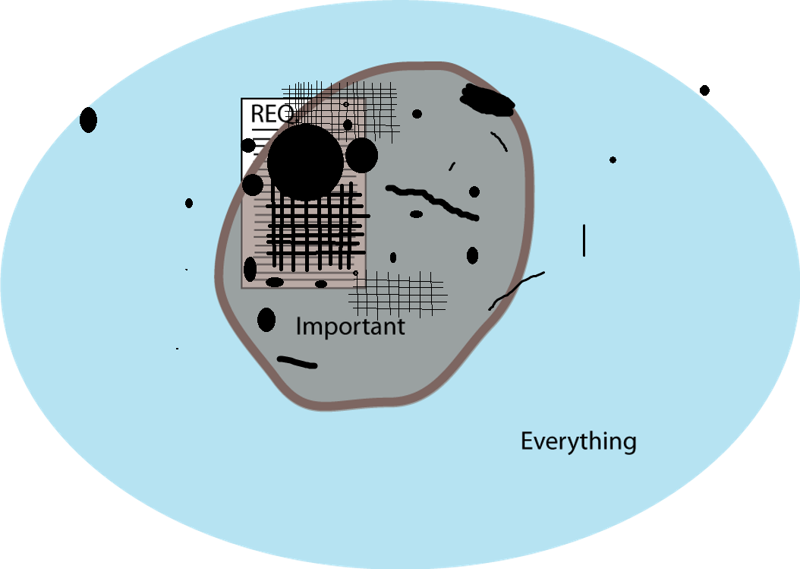
test different things in different ways, and always be ready for serendipity
serendipity
Notes:
In this next picture we have our test coverage after some testing. Some areas are very well covered, some a little, and some not at all.
The big circle in the middle could be really well-engineered unit and integration tests for business calculation, that’s the most critical part.
The thick lines are automated GUI tests, and our exploratory testing is a bit here and a bit there.
Different tests with different tools, and different testers will cover their part of ”what’s important*
There will still be holes, but we have a word for how to cover that.
That word is serendipity; that’s when you are looking for something, but find something else that is important.
I bet this has happened to you many, many times, you are testing something specific, but you find something important you just stumbled upon.
Serendipity is one part luck, but also requires skill and knowledge.
By knowing a lot about the software, its surroundings, its usage, its technical details, its context, we can see more than we knew about in advance.
So my second message today is ”test different things in different ways, and always be ready for serendipity”

Slide 4
Test Artifacts
Product History(Failures)
Quality Characteristics
Failure Mode
Searching
Debt
Users
Risks
Many Deliverables
Fears
Surroundings
Tools
You
Capabilities
Technologies
Legal aspects
Models
Standards
Usage Scenarios
Information Objectives
find your own 37 sources for test ideas, in your own time, and your own style
Conversations
Image
Data
Context Analysis
White-box
Internal Collections
Competitors
Public Collections
Actual software
Purpose
Business Knowledge
References
Field Information
Creative Ideas
Project Background
Notes:
But in order to do this well, we have to learn a lot.
My learning happens best incrementally, as I test and the project unfolds, I understand more and more, also about what I need to learn more about.
The potato might be hard to see in the beginning, but in the end it is three-dimensional and you can almost touch and smell it.
My friends Martin Jansson, Henrik Emilsson and myself created a generic list of possibles sources for information, useful for test ideas and for learning.
We will use that to fill the potato, because…
Besides knowing what the product can do, you will test better if you know how it can fail.
You might have diverse and rich models, also including the data the product is using.
If you understand the environment, and maybe even have access to the code, you can go deeper.
If you know the history, how it works today, and the technologies operating, you can tell what is going on.
If you know about your competition, the big purpose and the image your company wants, you can tell compelling stories about your findings.
If you understand the domain and its legal aspects you can find very important things,
And your creativity will enrich the internal collections of good test ideas that you have.
You will also use your own feelings and experience, and perhaps the backgrounds for the project happening.
If you have asked stakeholders about the information objectives, product risks will come from many places.
You will make use of test artifacts, and technical debt combined with conversations will help you towards the context analysis that really is your true understanding of what this is all about.
And there’s even more, your tools are a source of inspiration, and the quality characteristics I could talk about this for a long, long time.
So there’s a lot to learn, and all of these things will not be suitable.
The learning is an ongoing process that never ends, and things you knew will change.
But as you learn a lot from many different sources, combine things, look at many places, think critically and design your tests, you will certainly cover more of the important areas.
Some part is luck, but a large portion of hard work is needed. Serendipity is working to our advantage.
So my third message today is ”find your own 37 sources for test ideas, in your own time, and your own style”

Slide 5
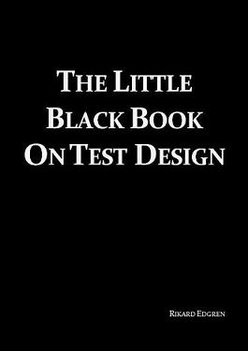
The Software Potato
TestFlix 2022
Rikard Edgren
http://www.thetesteye.com/papers/TheLittleBlackBookOnTestDesign.pdf
Notes:
And with that I want to thank you for listening.
I wish you the best of luck with your testing.
Goodbye.

